Slide 1


AMERCIAN INTERNATIONAL UNIVERSITY-BANGLADESH
COURSE: MACHINE LEARNING
SEMESTER: FALL 2024-25
SUPERVISOR: DR. MD. ASRAF ALI
Title: Human Facial Expression Detection Using Machine Learning
Group-06
Group Members:
Nowshin Fariha (22-47074-1)
Sumaiya Afrin Shashy (22-47098-1)
Md.Mahfuzur Rahman (22-47078-1)

Slide 2

Contents
Problem Statement
Research Background
Objective
Motivation
Methodology
Dataset Preparation
Feature Extraction Techniques
Result
Conclusion

Slide 3
Problem Statement
Introduction:
Facial expressions are a vital part of non-verbal communication, reflecting emotions and intentions. Machine learning enables automated recognition of facial expressions, supporting applications in security, healthcare, and human-computer interaction.
Related Work
Deep Learning Models: Convolutional Neural Networks (CNNs) have proven effective for analyzing facial expressions.
Lightweight Architectures: MobileNetV2 combines computational efficiency with strong performance.

Slide 4
Research Background
• Facial expressions are key to non-verbal communication but pose challenges for automated systems
- Healthcare: Assessing patient emotions.
- Security: Monitoring suspicious behavior.
- Entertainment: Enhancing user interaction.
- Human-Computer Interaction: Adaptive systems
Challenges Identified:
Class imbalance in datasets.
Variations in lighting and facial poses.
Dependency on large annotated datasets.

Slide 5
Objective
Problem Description:
Facial expression recognition systems struggle with real-world adaptability due to issues like limited labeled data, varying conditions, and computational constraints.
Proposed Solution:
Leverage the FER2013 dataset to train models.
Utilize enhanced CNN architectures like VGG19 and MobileNetV2.
Apply techniques such as data augmentation and transfer learning to improve generalization and efficiency.
Expected Outcomes:
High-accuracy detection and classification of facial expressions.
Real-time applicability in resource-constrained environments.
Improved user experience in adaptive systems.

Slide 6
Motivation
1. Growing demand for automated FER systems in real-time applications.
2. Societal benefits, including improved security systems and patient care.
3. Engaging educational platforms responsive to student emotions.
4. Emotion-based adaptive healthcare tools.

Slide 7
Methodology
Data Collection: FER2013 dataset with 35,887 labeled grayscale images across seven expression classes.
Preprocessing:
Normalize images to 48x48 pixels and standardize intensity values.
Apply augmentation techniques like rotation and scaling.
Model Selection:
Use CNNs as the core architecture (e.g., VGG19, MobileNetV2).
Compare performance with traditional classifiers like SVM and KNN.
Evaluation:
Metrics include accuracy, precision, recall, and F1-score.
Employ cross-validation to ensure robustness.
5. Classification:
Support Vector Machines (SVM): Effective for high-dimensional feature spaces.
K-Nearest Neighbors (KNN): Simple and effective for feature-based classification.
Convolutional Neural Networks (CNNs): Leverage hierarchical structures for deep feature extraction and classification.

Slide 8
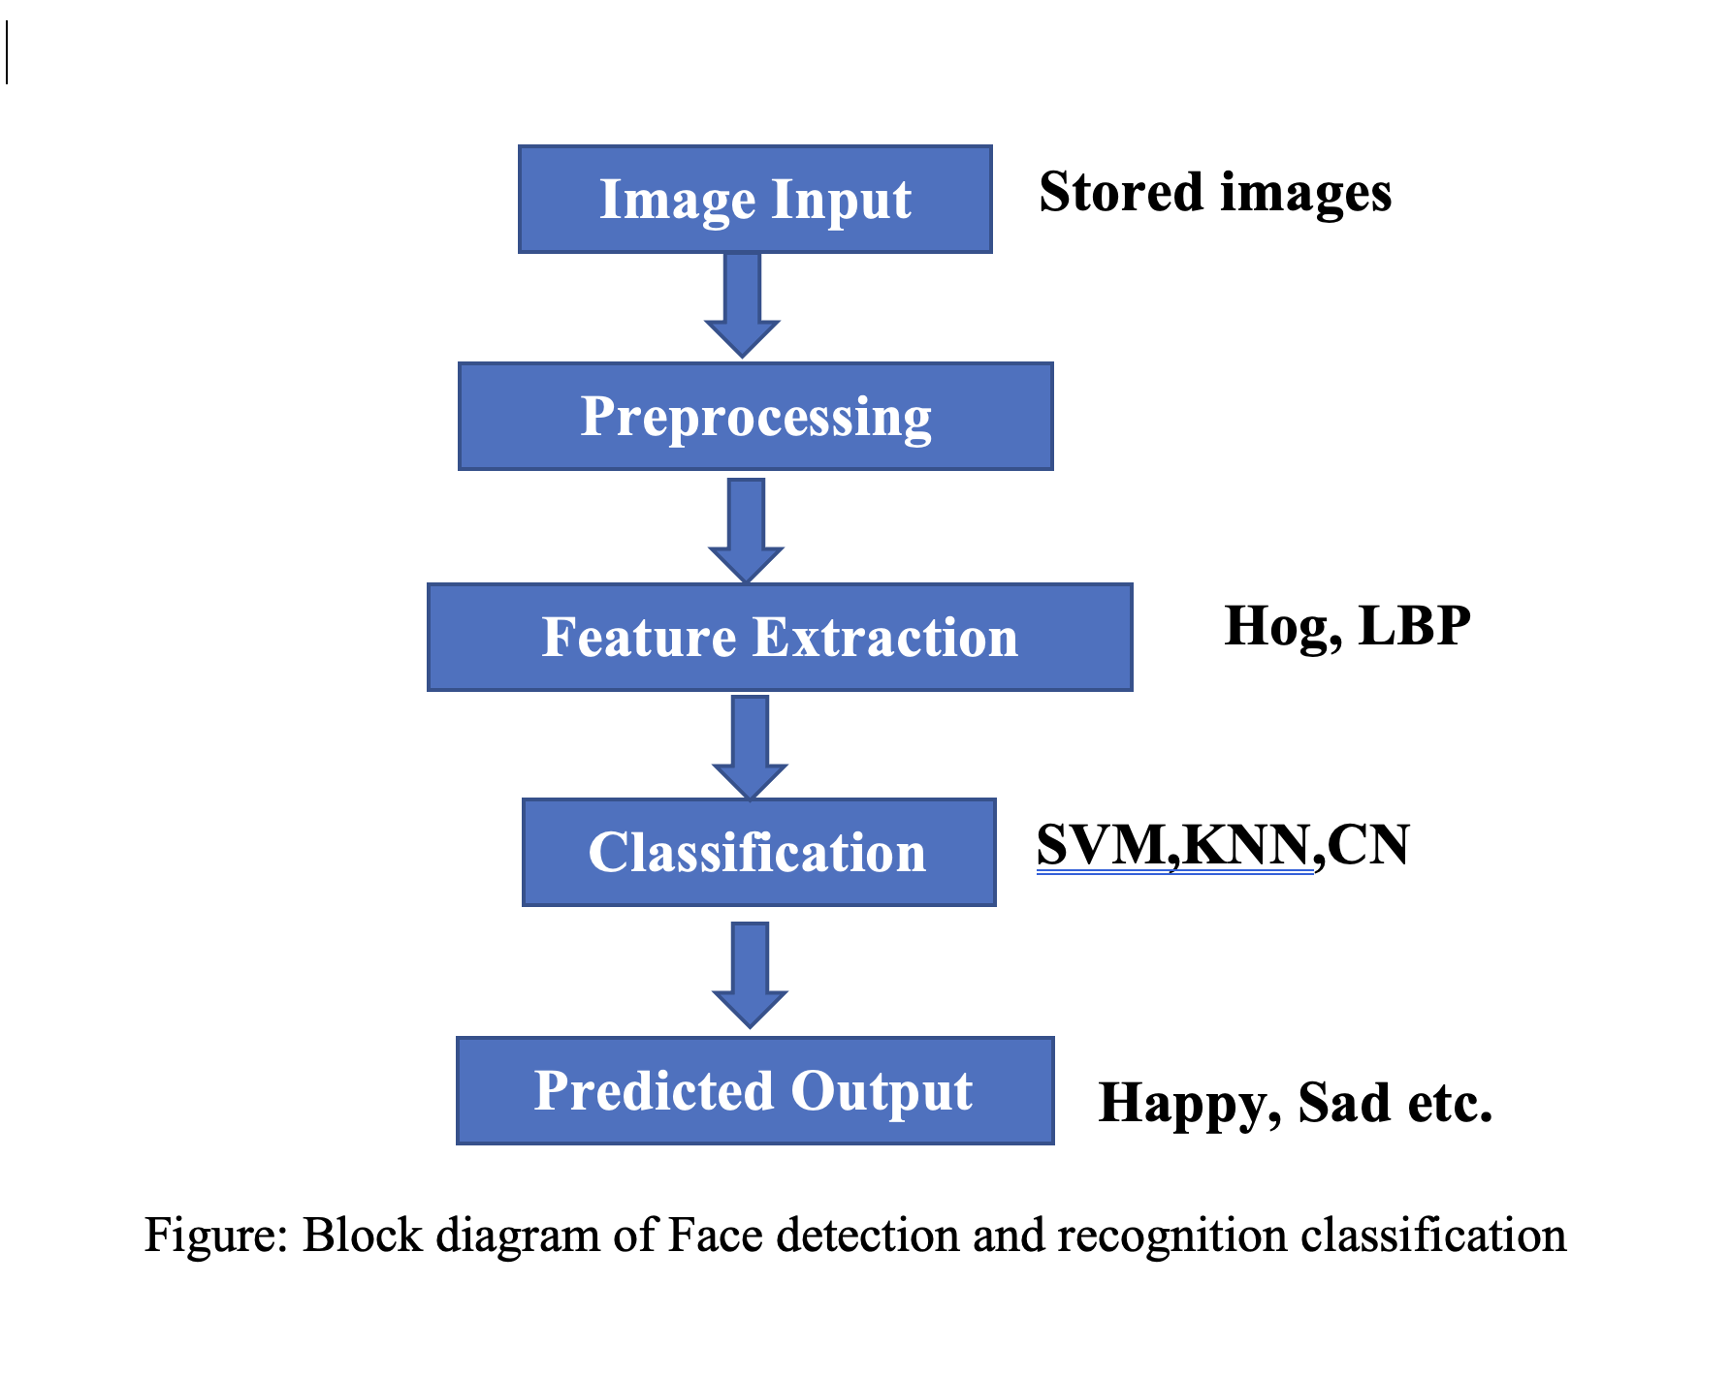
block Diagram of working methods:

Slide 9
Dataset Preparation
Dataset: FER2013
Size: 35,887 labeled grayscale images (48x48 pixels).
Classes: Angry, Disgust, Fear, Happy, Sad, Surprise, Neutral.
Preparation Steps:
-Collection Source: Kaggle’s FER-2013 dataset.
- Augmentation: Rotation, scaling, flipping.
- Splitting: 80% training, 20% testing.
Visualization: Balanced distribution across emotion classes.

Slide 10
Feature Extraction Techniques
Feature extraction focuses on identifying key facial characteristics for emotion.
1. Histogram of Oriented Gradients (HOG):
- Captures gradient orientation distribution.
- Robust to illumination changes.
2. Local Binary Patterns (LBP):
- Analyzes texture by comparing pixel intensities.
- Efficient for small datasets.
3. Gabor Filters:
- Extracts spatial frequency information.
- Effective for texture and edge details.

Slide 11
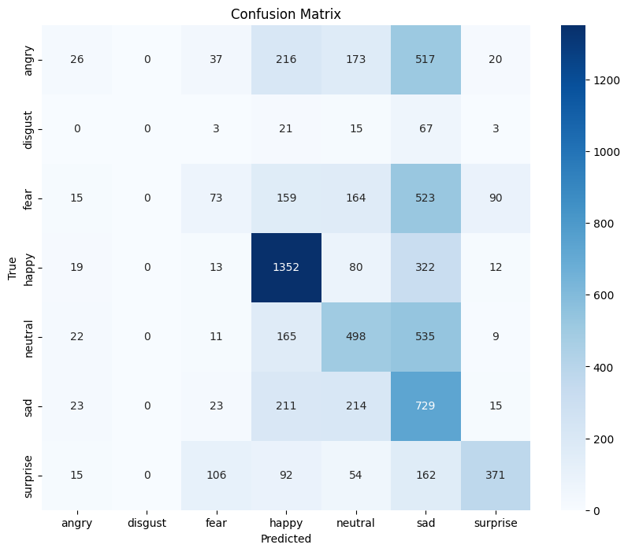
Result
Outcomes:
The developed system effectively classified facial expressions with high accuracy under various conditions.
Accuracy Metrics:
Model Accuracy obtained 0.4249
In only 3 epochs

Slide 12
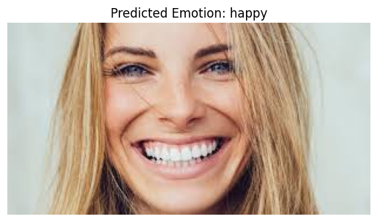

Result (CONTD.)
Input Data
Output Data

Slide 13
Conclusion
Summary of Results:
The system reliably recognized facial expressions, demonstrating adaptability in real-world scenarios.
The use of lightweight models enabled real-time applications.
Limitations:
Challenges remain in extreme lighting conditions or when facial features are occluded.
Dependence on large annotated datasets for optimal performance.
Future Scope:
Improve adaptability for multi-lingual and cultural variations.
Integrate hybrid models to enhance generalization.
Expand applications into adaptive healthcare and educational platforms.

Slide 14
THANK YOU

